Slide 1
Introduction to Machine Learning and Data Mining (Học máy và Khai phá dữ liệu)
Khoat Than
School of Information and Communication Technology
Hanoi University of Science and Technology

Slide 2
Contents
Introduction to Machine Learning & Data Mining
Supervised learning
K-nearest neighbors
Unsupervised learning
Practical advice

Slide 3
Classification problem
Supervised learning: learn a function y = f(x) from a given training set {{x₁, x₂, …, x_{N}}; {y₁, y₂,…, y_{N}}} so that y_{i} ≅ f(x_{i}) for every i.
Each training instance has a label/response.
Multiclass classification/categorization: output y is only one from a pre-defined set of labels
y in {normal, spam}
y in {fake, real}

Slide 4
Which class does the object belong to?
Class a
Class a
Class b
Class a
?
Class b
Class a

Slide 5
Neighbor-based learning (1)
K-nearest neighbors (KNN) is one of the most simple methods in ML. Some other names:
Instance-based learning
Lazy learning
Memory-based learning
Main ideas:
There is no specific assumption on the function to be learned.
Learning phase just stores all the training data.
Prediction for a new instance is based on its nearest neighbors in the training data.
Thus KNN is called a non-parametric method. (no specific assumption on the classifier/regressor)

Slide 6
Neighbor-based learning (2)
Two main ingredients:
The similarity measure (distance) between instances/objects.
The neighbors to be taken in prediction.
Under some conditions, KNN can achieve the Bayes-optimal error which is the performance limit of any methods. [Gyuader and Hengartner, JMLR 2013]
Even 1-NN (with some simple modifications) can reach this performance. [Kontorovich & Weiss, AISTATS 2015]
KNN is close to Manifold learning.

Slide 7
KNN: example
Take 1 nearest neighbor?
Assign z to class 2.
Take 3 nearest neighbors?
Assign z to class 1.
Take 5 nearest neighbors?
Assign z to class 1.
Class 1
Class 2
Class of z?

Slide 8
KNN for classification
Data representation:
Each observation is represented by a vector in an n-dimensional space, e.g., x_{i} = (x_{i1}, x_{i2}, …, x_{in})^{T}. Each dimension represents an attribute/feature/variate.
There is a set C of predefined labels.
Learning phase:
Simply save all the training data D, with their labels.
Prediction: for a new instance z.
For each instance x in D, compute the distance/similarity between x and z.
Determine a set NB(z) of the nearest neighbors of z.
Using majority of the labels in NB(z) to predict the label for z.

Slide 9
KNN for regression
Data representation:
Each observation is represented by a vector in an n-dimensional space, e.g., x_{i} = (x_{i1}, x_{i2}, …, x_{in})^{T}. Each dimension represents an attribute/feature/variate.
The output y is a real number.
Learning phase:
Simply save all the training data D, with their labels.
Prediction: for a new instance z.
For each instance x in D, compute the distance/similarity between x and z.
Determine a set NB(z) of the nearest neighbors of z, with |NB(z)| = k.
Predict the label for z by

Slide 10
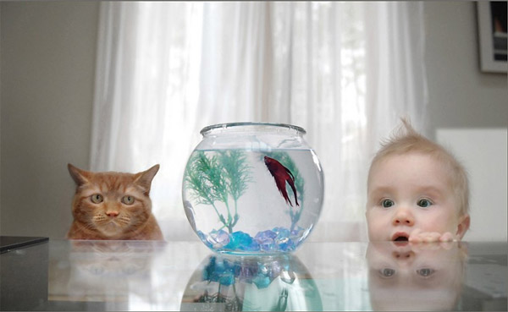
KNN: two key ingredients (1)
Different thoughts,
Different views
Different measures

Slide 11
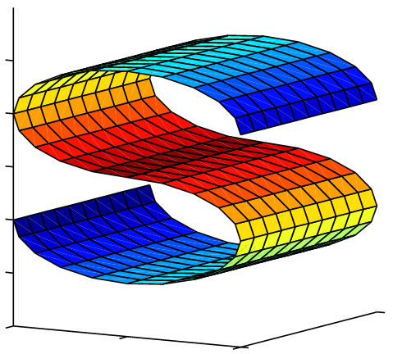
KNN: two key ingredients (2)
The distance/similarity measure
Each measure implies a view on data
Infinite many measures !!!
What measure should be?

Slide 12
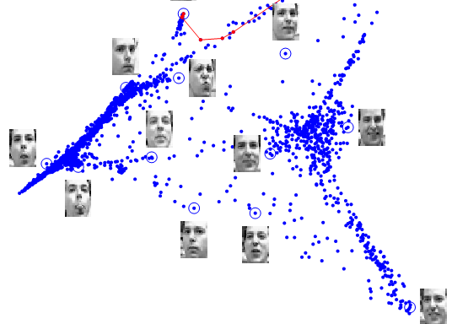
KNN: two key ingredients (3)
The set NB(z) of nearest neighbors.
How many neighbors are enough?
How can we select NB(z)? (by choosing k or restricting the area?)

Slide 13
KNN: 1 or more neighbors?
In theory, 1-NN can be among the best methods under some conditions. [Kontorovich & Weiss, AISTATS 2015]
KNN is Bayes optimal under some conditions: Y bounded, large training size M, and the true regression function being continuous, and
In practice, we should use more neighbors for prediction (k>1), but not too many:
To avoid noises/errors in only one nearest neighbor.
Too many neighbors migh break the inherent structure of the data manifold, and thus prediction might be bad.

Slide 14
Distance/similarity measure (1)
The distance measure:
Plays a very important role in KNN.
Indicates how we assume/suppose the distribution of our data.
Be determined once, and does not change in all prediction later.
Some common distance measures:
Geometric distance: usable for problems with real inputs
Hamming distance: usable for problems with binary inputs, such as x in {0; 1}

Slide 15
Distance/similarity measure (2)
Some geometric distances:
Minkowski (L_{p}-norm):
Manhattan (L₁-norm):
Euclid (L₂-norm):
Chebyshev (max norm):

Slide 16
Distance/similarity measure (3)
Hamming distance:
for problems with binary inputs
such as x = (1,0,0,1,1)
Cosine measure:
Suitable for some problems with textual inputs.

Slide 17
KNN: attribute normalization
Normalizing the attributes is sometimes important to get good predictiveness in KNN.
No normalization implies that the magnitude of an attribute might play a heavy role, and artificially overwhelms the other attributes. Ex.:
x = (Age=20, Income=12000, Height=1.68)
z = (Age=40, Income=1300, Height=1.75)
𝑑(𝒙, 𝒛) = [(20−40)² + (12000−1300)² + (1.68−1.75)²]^{0.5}
This is unrealistic and unexpected in some applications.
Some common normalizations:
Make all values of x_{j} in [-1; 1];
Make all values of x_{j} to have empirical mean 0 and variance 1.

Slide 18
KNN: attribute weighting
Weighting the attributes is sometimes important for KNN.
No weight implies that the attributes play an equal role, e.g., due to the use of the Euclidean distance:
This is unrealistic in some applications, where an attribute might be more important than the others in prediction.
Some weights (w_{i}) on the attributes might be more suitable.
How to decide the weights?
Base on the knowledge domain about your problem.
Learn the weights automatically from the training data.

Slide 19
KNN: weighting neighbors (1)
Prediction of labels miss some information about neighbors.
The neighbors in NB(z) play the same role with respect to the different distances to the new instance.
This is unrealistic in some applications, where closer neighbors should play more important role than the others.
Using the distance as weights in prediction might help.
Closer neighbors should have more effects.
Farther points should have less effects.
z

Slide 20
KNN: weighting neighbors (2)
Let v be the weights to be used.
v(x,z) can be chosen as the inverse of the distance from x to z, d(x,z).
Some examples:
For classification:
For regression:

Slide 21
KNN: limitations/advantages
Advantages:
Low cost for the training phase.
Very flexible in choosing the distance/similarity measure: we can use many other measures, such as Kullback-Leibler divergence, Bregman divergence,…
KNN is able to reduce some bad effects from noises when k > 1.
In theory, KNN can reach the best performance among all regression methods, under some conditions. (this might not be true for other methods)
Limitations:
Have to find a suitable distance/similarity measure for your problem.
Prediction requires intensive computation.

Slide 22
References
A. Kontorovich and Weiss. A Bayes consistent 1-NN classifier. Proceedings of the 18th International Conference on Artificial Intelligence and Statistics (AISTATS). JMLR: W&CP volume 38, 2015.
A. Guyader, N. Hengartner. On the Mutual Nearest Neighbors Estimate in Regression. Journal of Machine Learning Research 14 (2013) 2361-2376.
L. Gottlieb, A. Kontorovich, and P. Nisnevitch. Near-optimal sample compression for nearest neighbors. Advances in Neural Information Processing Systems, 2014.

Slide 23
Exercises
What is the different between KNN and OLS?
Is KNN prone to overfitting?
How to make KNN work with sequence data? (each instance is a sequence)

